Slide 1





IICT Project Presentation

Slide 2

Our Team
AIMAN NASIR
(25I-2595)
FARYAL SHAKEEL
(25I-2586)
AISHA IRSHAD
(25I-2562)

Slide 3



Budget Living Hub
Budget Living Hub is a simple website created to help people deal with rising prices. It guides users to nearby markets where they can find good products at affordable rates. Our aim is to make everyday shopping easier, clearer, and less stressful during inflation.

Slide 4
Website Purpose
To help people find affordable and good-quality products in nearby local markets.
To help people find affordable and good-quality products in nearby local markets.
To make everyday buying decisions easier, faster, and more budget-friendly for users.

Slide 5
Overview
Welcome Page:
Community News:
Introduces the platform and guides users into the website.
Shares updates, announcements, and news relevant to local communities.
Directory:
Local Events:
Lists local markets, shops, and services with helpful details.
Highlights upcoming events, activities, and gatherings happening nearby.
Resource Center:
Feedback:
Provides useful information, tips, and budget-friendly guides for users.
Allows users to give feedback and reach out for support or inquiries.

Slide 6
Key Features
1
2
3
Real-Time Price Tracking
Affordable Shopping Guides
Community Events & Workshops
4
5
Local Business Directory
Light/Dark Mode with Modern UI

Slide 7
Design Highlights
1
2
3
User-Friendly Interface
Responsive Design
Visual Appeal
4
5
6
Dark/Light Mode Toggle
Interactive Elements
Local Market Focus

Slide 8
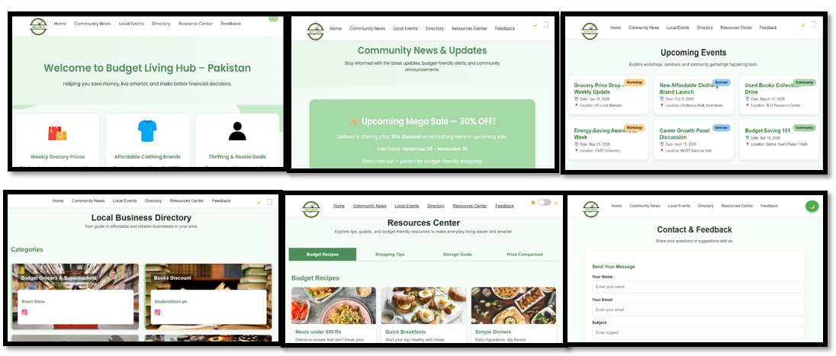
Demo

Slide 9
Challenge Faced
  Collecting accurate and up-to-date information about local markets was time-consuming.
  Designing a website that is both visually appealing and user-friendly without using JavaScript.
  Ensuring compatibility across different devices and screen sizes.
  Managing and organizing large amounts of data for local products and offers.

Slide 10
What We Learned
Improved skills in HTML and CSS for responsive web design
Learned how to implement light/dark mode using only CSS.
Gained experience in designing user-centric interfaces.
Understood the importance of local market research and real-time data.

Slide 11
Conclusion
Our project demonstrates how a simple website can help people find quality products at affordable prices in their local markets. Through this work, we learned practical web design skills, problem-solving, and the importance of making information accessible to everyone. Overall, it was a valuable experience that combined technology with real-world impact.

Slide 12
Q&A Session

Slide 13
Thank You

